Slide 1
Defender for IoT - From Planning to Deployment
Amir Sternberg
Senior Program Manager
Azure Partner Security Deep-Dive

Slide 2
Agenda
Key Success Factors
From Plan to Deployment Process
Overcoming Organizational Challenges With Azure Defender for IoT
Roles and Responsibilities Matrix (R.A.C.I)
Deployment Strategy
Prepare for Tomorrow (TODAY)
Key Takeaways

Slide 3
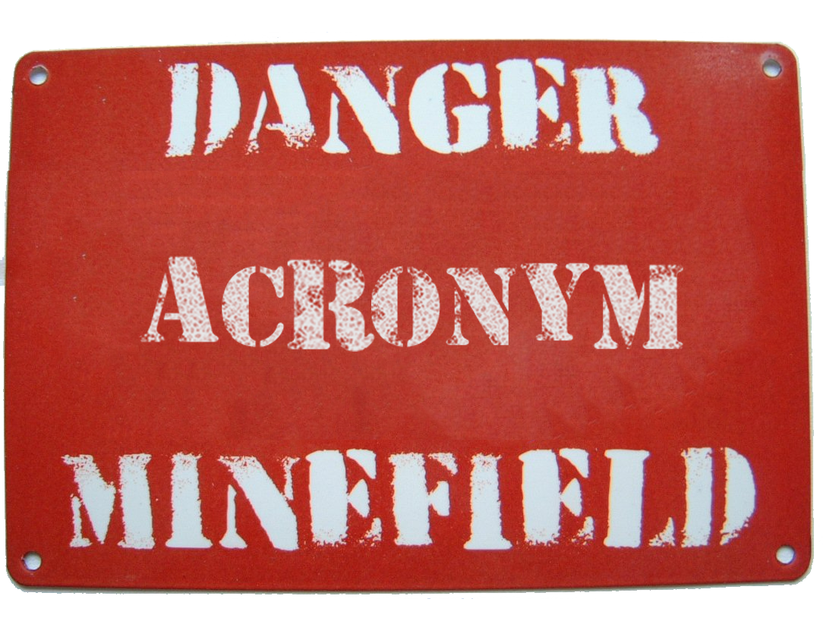
Acronyms (Just before we start)
SOC - Security Operations Center
SoW - Statement of Work
KOM - Kick off Meeting
VM - Virtual Machine, HW – Hardware
RO - Read Only
Admin - Administrator
SIEM - Security Information and Event Management
RACI - R = Responsible, A = Accountable, C = Counseled, I = Informed
AD – Active Directory
This Photo by Unknown Author is licensed under CC BY-NC-ND

Slide 4

Key Success Factors
Three Main Pillars
Diligent project planning
Expectations settings
Communication

Slide 5
Deployment Process Introduction
The next slides present Azure Defender for IoT deployment steps.
Each slide explains:
Step entry criteria
Dependencies
Deliverables
Success criteria

Slide 6
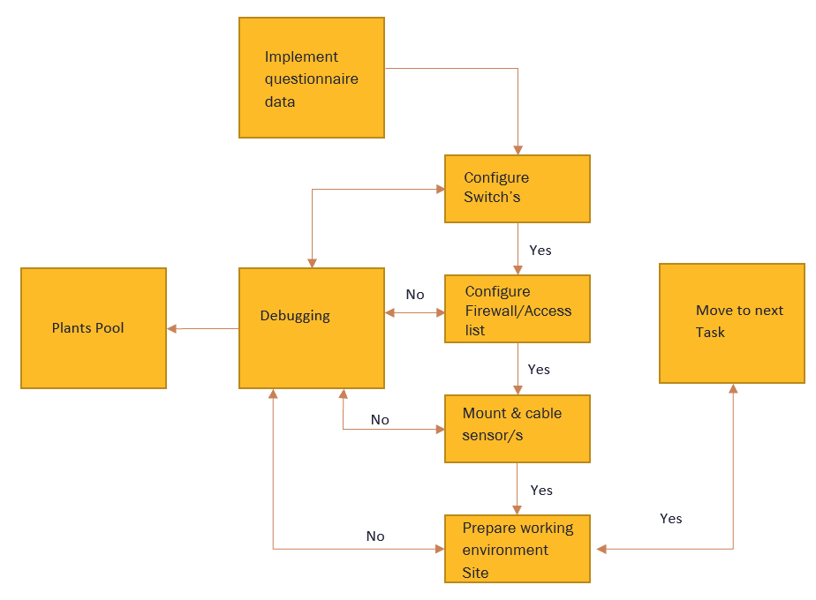
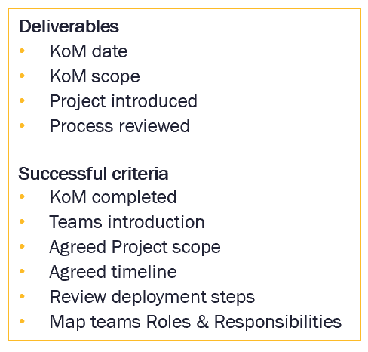




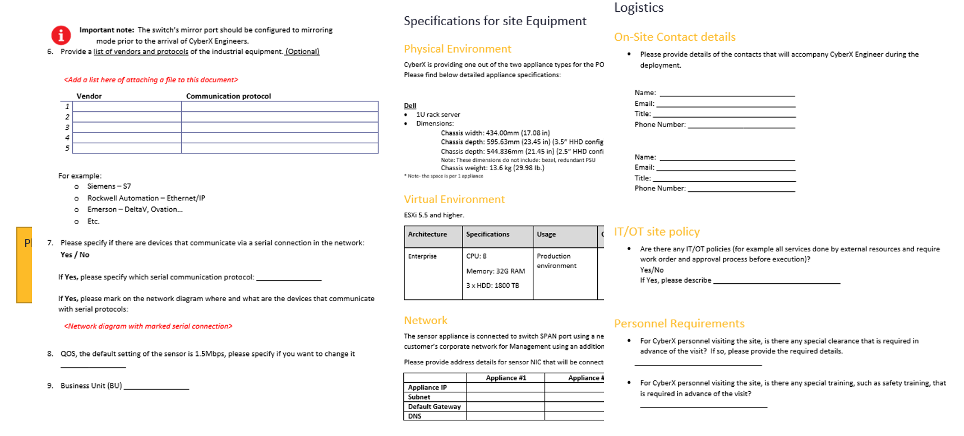
Defender for IoT - 9 Step from Plan to Deployment Process
Task 1 – Kickoff Meeting
Task 2 – Site Allocation
Task 3 – Site Architecture Review
Task 4 – Gathering Site Information
Task 5 – Site Configuration
Task 6 – Site Deployment Diagram
Task 7 – Site Tuning and Acceptance
Task 8 – Central Manager Deployment
Task 9 – SOC Enablement Workshop
Computer Servers
Internet
Router
PSTN Trunks/ PRI Lines
Wireless Controller
UTM/ Firewall
NAS – Network Area Storage
IP Telephony Server
Core Switch
Distribution Switches
Edge Switches
IP Surveillance Cameras
Wireless Access Points
Successful
Deployment
PC
Soft Phones
MFP/ Network Printers
IP Phones
IP Video Conf
Scanner
Initial
Meeting
1
2
3
4
5
6
7
8
9
Timeline

Slide 7




Task 1 – Kickoff Meeting
SoW signed
Deliverables
KoM date
KoM scope
Project introduced
Process reviewed
Set KoM, allocate participates
Yes
Success Criteria
Prepare working Env.
KOM
KoM completed
Teams introduction
Agreed Project scope
Agreed timeline
Review deployment steps
Map teams Roles & Responsibilities
Yes
No
Project - Green Light
Expert Tip
Make sure to correctly identify the key stakeholders
Different industries have different roles and responsibilities.

Slide 8
Overcoming Organizational Challenges With Azure Defender for IoT
Identify Executive Sponsorship
Have regular “on-site” status meetings with executive management (recommended at least quarterly at a minimum)
Partnership and Mutual Accountability
Business agreement defines behavior…
Ensure it is written for a committed mutual success (deployment strategy, timeline, yearly targets, resources, milestones, etc.)
Organizational Alignment Workshop
Build strong technical project team
Identify key people to sponsor the project locally and regionally
Define roles and responsibilities within different groups
Identify early adopters' sites and deploy them first (it will help you to sell solution to rest of the sites)
Identify issues and plan together accordingly
Logistics issues
Technology issues
Process issues

Slide 9

Task 2 – Site Allocation
Deliverables
Site allocation call/meeting
List of sites + contacts
Onboarding kit
Site team assigned
Project introduced
Process reviewed
Site pool review/selection
Project introduction call
Yes
No
Site - Green Light
Success Criteria
Sites gave green light to proceed
Sites list provided with contact details
Expert Tips
A good site pool will allow handling unexpected challenges and allow quick resolution cycle

Slide 10
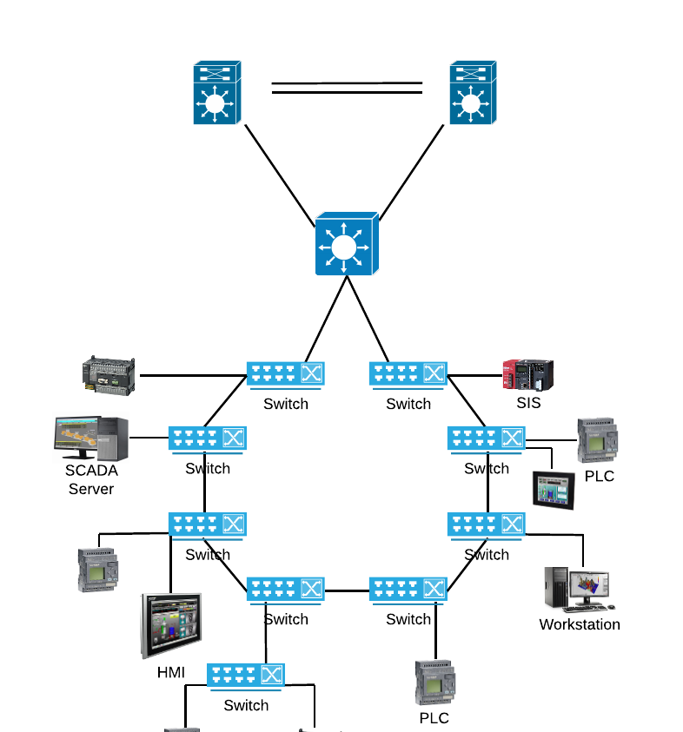
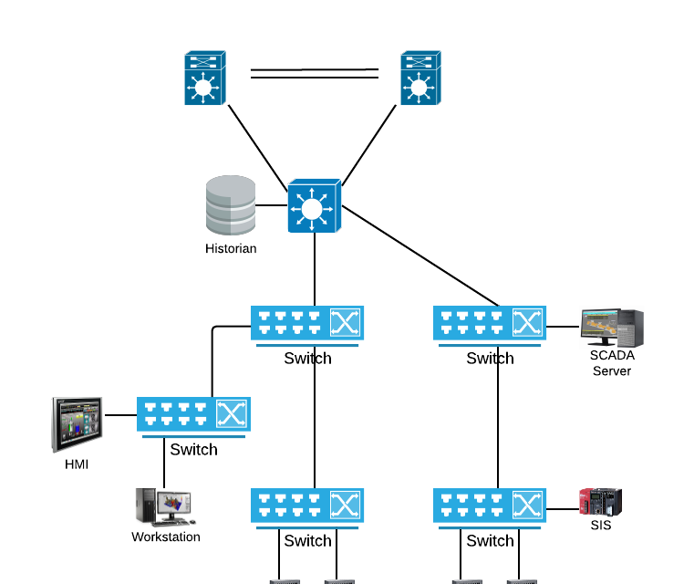
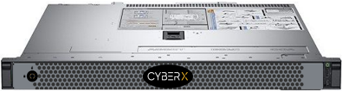
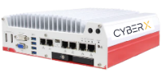
Task 3 – Site Architecture Review
Deployment kit provided
Yes
Establish deployment recommendation
Yes
Review and agree on site architecture
Deliverables
Ring
Deployment Kit
Site questionnaire
Product documentations
Site Playbook
Hardware ordered/VM allocated
Tree / Star
IT
IT
Computer Servers
OT
Internet
OT
Router
Mirror
Traffic
PSTN Trunks/ PRI Lines
Wireless Controller
UTM/ Firewall
Appliance
Success Criteria
NAS – Network Area Storage
IP Telephony Server
Mirror
Traffic
Mirror
Traffic
Core Switch
Deployment kit delivered
Architecture reviewed & agreed
Hardware ordered
Distribution Switches
Edge Switches
Mirror
Traffic
Expert Tips
Appliance
Wireless Access Points
IP Surveillance Cameras
Sometime a path forward requires compromise that will have a minor cost in terms of sensor location
PC
Soft Phones
MFP/ Network Printers
IP Phones
IP Video Conf
Scanner

Slide 11

Task 4 – Gathering site Information
Deliverables
Provide deployment kit
Site deployment questionnaire” document
No
Complete site questionnaire
Debugging
Success Criteria
Yes
No
Identify & solve blockers
Information provided by site and approved by partner
No Blockers/mitigation plan
Blockers Example
Expert Tips
Non-managed switch
3rd party manage the switch and not cooperating
Site is not cooperating
No rack space
Costly adaptation is always a solution but should be prioritized after exhausting all creative alternatives

Slide 12

Task 5 – Site Configuration
Implement site survey data configuration
Deliverables
Switches and Firewall configured
Physical connectivity completed
Sensor connected and powerup
Eng. workstation ready
No
Switch Configuration
Debugging
Yes
No
Firewall configuration
Yes
Success Criteria
Mount & Cable Sensors
Switches and Firewall configured
Sensors mounted and cabled
Yes
Expert Tips
Identifying the correct people to preform the needed change is key for a fast completion
Prepare working Env.

Slide 13
Task 6 – Sensors Deployment
Session scheduling and access and tools preparation
Deliverables
UI/CLI Accessible
Traffic reaches and discovered by sensors
Dashboards provide valid data
Alerts/Events are being reported in the sensor
Install and configure sensors
Yes
Debugging
No
Post installation validation
Success Criteria
Optional
Optional
Sensors installed & function as expected
SOC is monitoring the platform
Handover to site team completed
Integrate sensors to central Management
Initial knowledge transfer
Expert Tips
Using secure remote MGMT services as ILO/IDRAC can provide an additional layer of connectivity

Slide 14
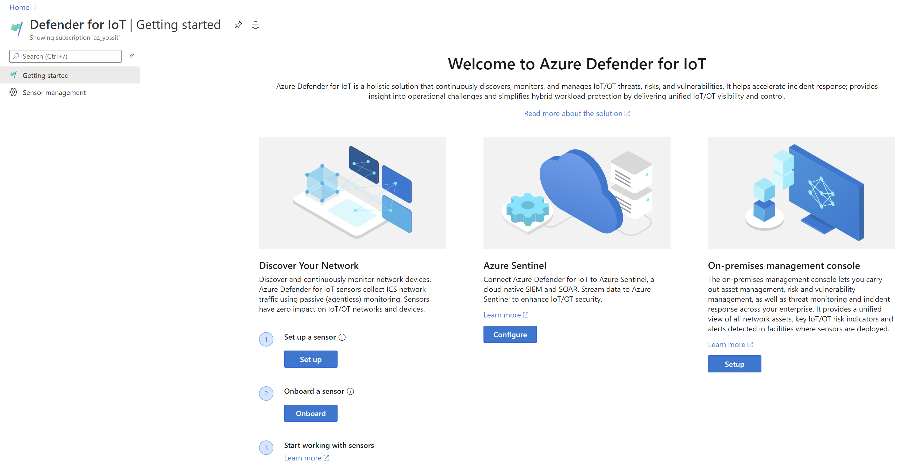

ISO and Activation
Confidential

Slide 15
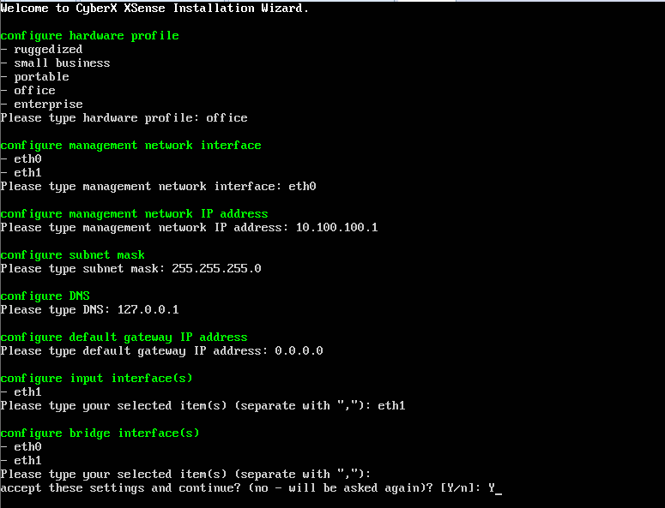
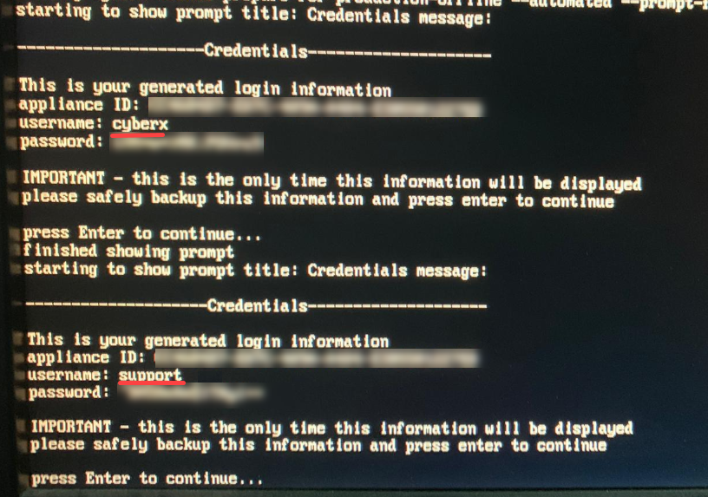
Image Installation Process
Boot from ISO image
Choose SW architecture
Corporate
Enterprise
SMB
Line
Choose management interface
Define management network parameters
Choose monitoring interfaces
Receive initial password

Slide 16
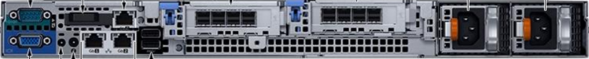
Before Connecting to the Switch
Connect the Mgmt port (GB1) and iDRAC (optional) to customer’s network
Browse to the static IP for login to Defender for IoT GUI
Initially login with “support” user
Activate the product
Go to System Settings and configure System Timezone
iDRAC
Gb1 - Mgmt
Example: Dell R340

Slide 17
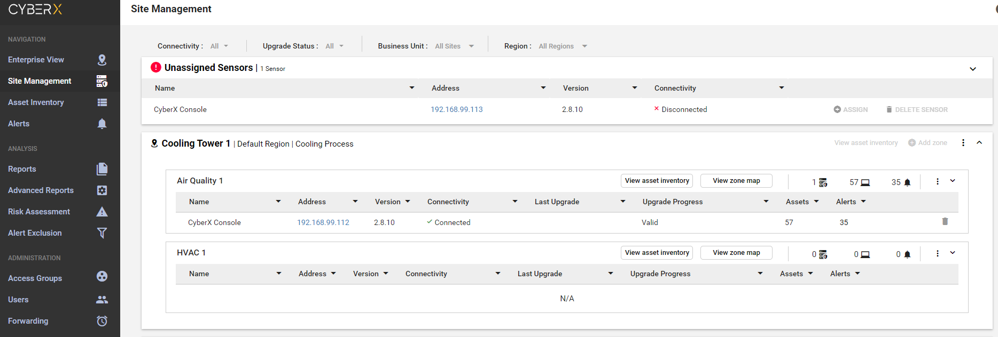
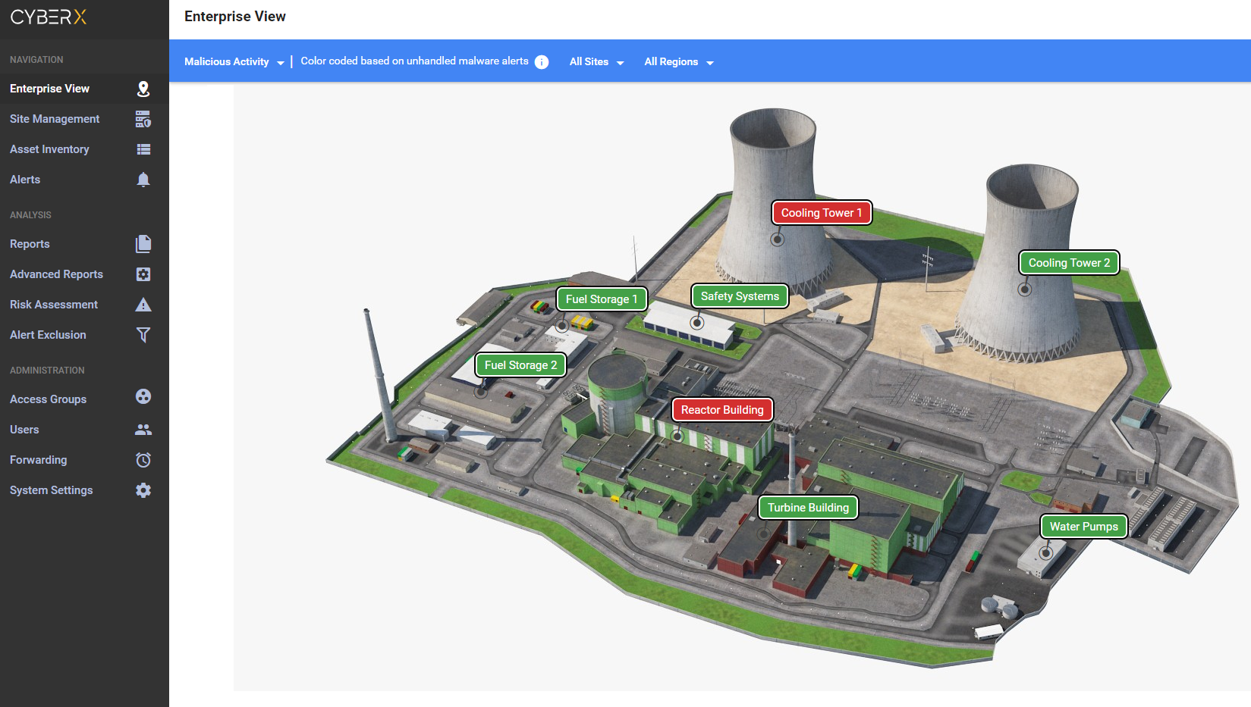
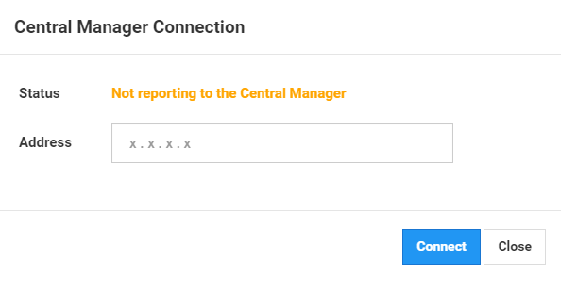
Connect to Central Management
CM
Sensor
Confidential

Slide 18
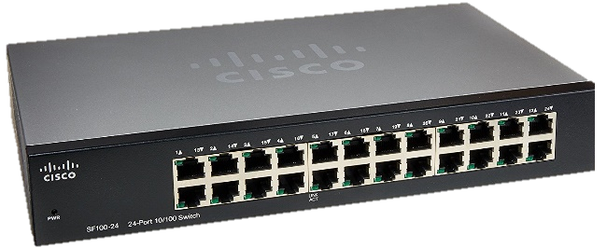
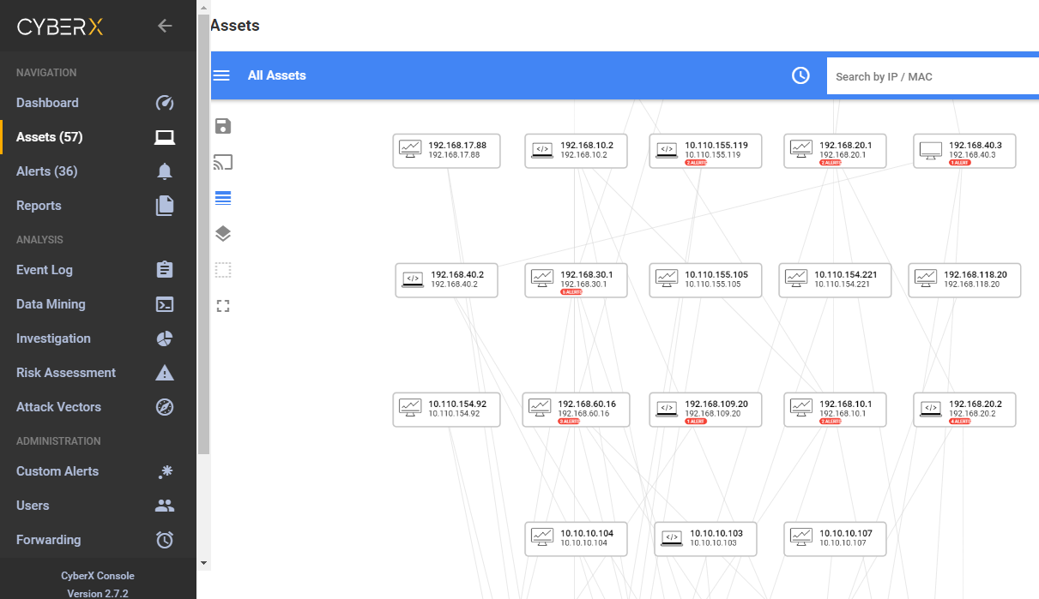
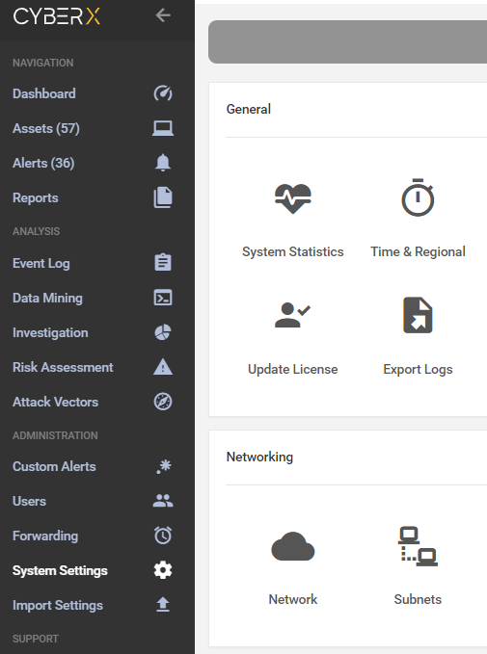
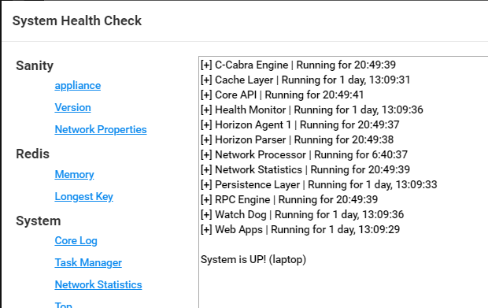
Connect to the Monitored Switch
Connect the monitoring port to switch’s SPAN destination port
Login to Defender for IoT GUI and perform basic sanity check:
Asset map: Devices are discovered, unicast connections
System Settings > System Statistics -> Appliance: System is UP!
Monitoring ports
SPAN Port
Confidential

Slide 19

Task 7 – Sensors Tuning & Acceptance
Sensor learning & tuning period
Deliverables
Sensor tuning
Signed acceptance form
Learning period
Yes
Success Criteria
Debugging
No
Tuning process
Sensor deployment completed
Sensor is tuned
Sensor is under SOC monitoring
Deployment completed and acceptance signed
Yes
Sensor acceptance
Yes
Expert Tips
Most fine tunning can and should be done on the day of the deployment

Slide 20
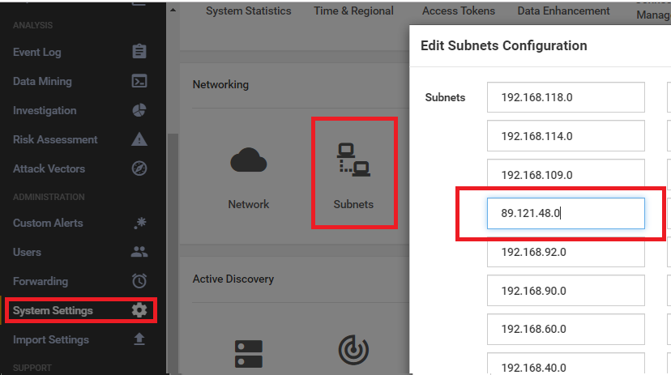
Manual Tuning
Step #1: Review Open Alerts
Step #2: Review Subnet masks
Step #3: Identify public addresses that are used internally
Step #4: Define Important/Crown Jewel assets
Step #5: Optional - Import authorized device names
Confidential
Public IP Range

Slide 21
Task 8 – Central Manager Deployment
Partner to provide required HW/VM resources and software
Deliverables
VM technical requirements
CM software and license
HW/VM resources allocated
Yes
Success Criteria
Debugging
Install Central Manager
Central Manager deployment complete
CM installed and configured
Integration with 3rd parties like SIEM, Syslog server, SNMP, Backup server
Yes
Central Manager Settings
Expert Tips
Yes
Integration with Sentinel and other 3rd parties
A CM provides a single point for multiple cross sensor actions (Upgrade, TI, Exclusion Role, AD and more)
Yes

Slide 22

Task 9 – SOC Enablement Workshop
SOC Enablement workshop – Discuss with customer security use cases
Deliverables
SOC use cases example
SOC use case document
Agree on required security use cases
Yes
Success Criteria
Prepare SOC use cases document
SOC enablement completed and tested
Workshop completed
SOC use case document approved by customer
Yes
Approve the document
Expert Tips
Yes
Sentinel provides the best integration for Azure Defender for IoT. Want to prove to the customer? Have him try it!
Implement based on native (Sentinel) or 3rd party tool
Debugging
Yes

Slide 23
RACI Matrix Map – CM Deployment
RACI Matrix Map – Site Deployment
Responsible - person who performs an activity or does the work.
Accountable - person who is ultimately accountable and has Yes/No/Veto.
Consulted - person that needs to feedback and contribute to the activity.
Informed - person that needs to know of the decision or action.
Task or Activity | Partner | Customer PM | Sites | Network | Procurement | Security
Preparation
Project kick-off planning call/meeting | R | R | I | I | I | I
Site preparation
Assign dedicated project teams | IC | R | CA | CA | CA | CA
Provide site deployment kit | R | I | I | I | I | I
Review architecture diagram with network topology and agree site design | R | R | RA | R | I | IC
Order site appliance(s) (based on agreed design) | IC | R | I | I | R | I
Fill site questionnaire | IC | R | R | C | I | C
Identify and solve blockers | R | R | C | C | C | C
Create necessary firewall rules for sensors devices console interface | IC | R | IC | R | I | R
Create spanning ports on switches for port monitoring | IC | R | C | R | I | I
Prepare a workstation environment | IC | R | R | I | I | I
Prepare rack space, mount and cable Sensor appliances and switches | IC | R | R | I | I | I
Create users in Active Directory/local users | I | R | R | I | I | R
Install Sensor MIB in customer SNMP (if applicable) | IC | R | I | R | I | I
Install TAP devices
Internal On-site Deployment Readiness Checklist | I | R | R | R | I | R
Go No Go (checklist review) | R | R | RA | RA | I | RA
Agree deployment date | R | R | I | I | I | I
Task or Activity | Partner | Customer PM | Sites | Network | Procurement | Security
Deployment
Deploy Sensor(s) software and configuration
Post-deployment verification
Connect Sensor to management (if applicable), configure alert forwarding
Connect to SNMP server
Hands-on initial knowledge transfer
Sensor/s learning period
Baseline fine tuning
Acceptance sign
Task or Activity | Partner | Customer PM | Sites | Network | Procurement | Security
Site preparation
SOC enablement workshop
Create SOC use cases documents
Approve SOC use cases
Provide Syntax rules (in case of Syslog server use)
Provide VM resources requirements
Prepare VM environment
Download SIEM system Defender add-on (if applicable like QRadar, Panorama)
Prepare Syslog server (optional)
Create Active Directory users/local users
Deployment
Install Central Manager
Central Manager configuration
Integrate with Syslog server
Integrate with SIEM system
Post-deployment verification
Baseline fine tuning
adjusted per project scope
And Industry

Slide 24

Deployment Strategy
Strategy generally involves setting goals, determining actions to achieve the goals, and mobilizing resources to execute the actions
Goals – set targets (X sites will deploy in 2021)
Actions – Remote or Onsite (Critical sites onsite, rest remotely)
Resources – Partner, Customer or Joint

Slide 25

The world is changing… So Are We
Remote Deployment Strategy
Deployment can be done anywhere in the world
Today I deploy in New York, tomorrow in Tokyo
Better flexibility
Much easier to support last minute change (TZ)
Higher volumes
No travel time, less costs spent on traveling
The right team any time
Assemble the right resources WW at ease

Slide 26


Remote strategy – One Region
America Region
EMEA Region
APAC Region

Slide 27
Prepare for Tomorrow (TODAY)
Identify who will monitor the system, and will handle alerts and events
Identify user roles
SOC team –Tier 1 - RO, Tier 2 - Analyst
Security officers - Analyst
Site team - RO
Other team – RO, Analyst
Identify who will manage (admin) Defender for IoT system
SOC team
Other team (do you have available resource, or you need to hire?)
How you are planning to manage users (local, by AD)
How do you plan to support site deployments (site preparations, deployment day)
Local teams
Global team
Train your team – Get the best out of the system

Slide 28

Key Takeaways
Follow project planning methodologies
Propper expectations setting
Transparent continues communication
Never lose sight of the goal line

Slide 29

Learn more
Tech Community:
IoT Security - Microsoft Tech Community
Learn about product at:
http://aka.ms/ADforIoT-Product
http://aka.ms/ADforIoT-PP-Blog
Product Documentation
Azure Sphere | Microsoft Azure
View on-demand webinars:
SANS: Bringing IT & OT Together — Expert Roundtable
SANS: A Principal Control Engineer’s Perspective on Defending Energy Utilities from IoT/ICS Attacks
Zero-Trust for IoT/OT Networks
Read our white papers, solution briefs & blog posts
MITRE ATT&CK for ICS
NIST Recommendations for IoT/ICS Security
TRITON Attack & OT Living-Off-The-Land Tactics
How IoT is Changing the CISO Role (Dark Reading)
Security Maturity Model
Notes:
We invite you to join our IoT security community and or access these resources to learn more

Slide 30
Questions?

Slide 31
Thank you. Amir Sternberg amirst@microsoft.com

